Slide 1

Apache Spark

Slide 2
Agenda
Recap of Hadoop
Limitations of Hadoop
Opportunity for In memory computing
Spark Ecosystem
Time comparisons with Map Reduce
History Review
Conclusion

Slide 3
Traditional tools for data analysis
SAS
SPSS
R
Python
All have one common problem, they all run on single machine..!!!

Slide 4

It all started in 2000’s
The word Internet – Connecting machines over the network has led to explosion of data.
Around in the same time, Google had a problem in storing this massive amount of data and process the same.
For storage, Google file system is designed
For processsing, Map reduce is designed
The image which is in the back ground, is Google data center, with 50000+ commodity machines.

Slide 5

Hadoop - 2004
Doug cutting, designed a web crawler, to crawl the data from web. But imagine, world wide web has zillion documents, how would one store that?
Doug had the same question and he read google white paper, and re implemented it.
Now what can be the name of tool? Ask his Kid, he knows it better!! His kid’s toy elephant name is hadoop!!

Slide 6
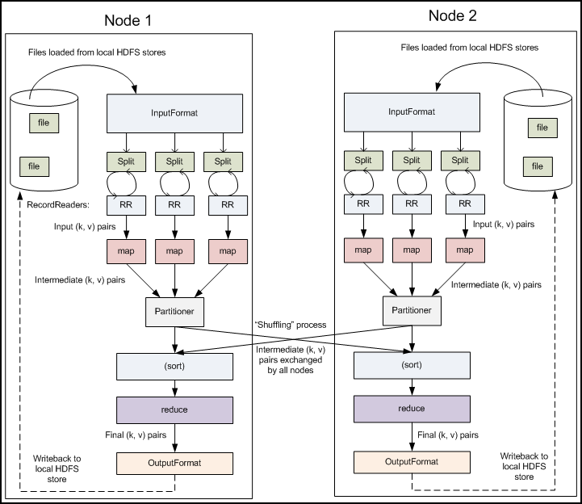
Recap of Map Reduce
Stages in map phase; Inputformat, split, record reader, mapper, partitioner stages .
Stages in reduce phase; Shuffle, sort, reduce, outputformat, record writer.

Slide 7
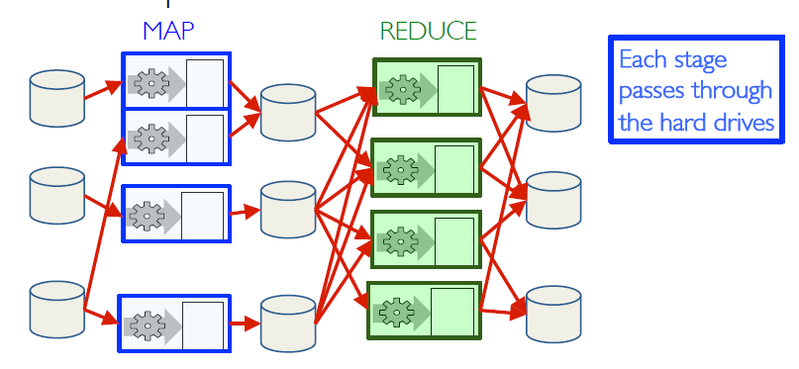
Map Reduce Distributed Execution
In map reduce, each stage passes through disk.
Input Data is on HDFS
Output of mapper is on local disk
Output of Shuffle and sort is on local disk
Output of reducer will be written back to HDFS
If you carefully observe, map reduce is disk IO intensive.

Slide 8
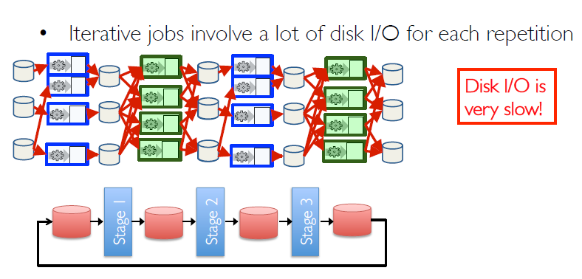
Map Reduce: Iterative jobs
Now think about iterative jobs. Say there are multiple map reduce stages, and each
Stage involves disk I/O. In the above diagram, there will be 6 local disk I/O’s and 6 HDFS I/O
Operations.
Now you understand, why map reduce is slow!!

Slide 9
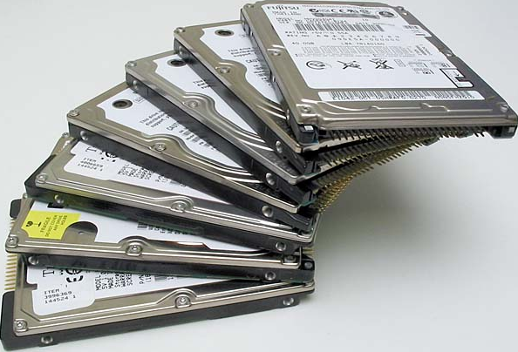
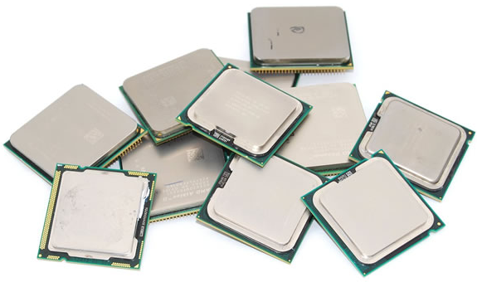
Hardware for Big Data
By this time, you should have understood
The hardware ware for bigdata is:
Many Hard disks
Many CPU’s

Slide 10
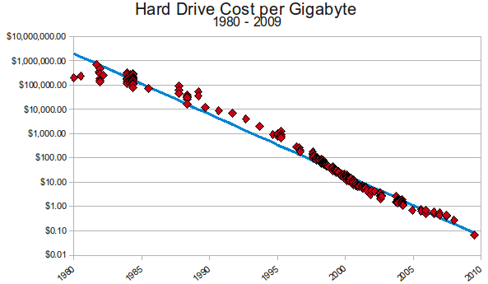
Why so many hard disks?
As you see, cost per gb over the years is linearly coming down, and now it has become so cheap!!

Slide 11
University of california had a question
In a big data cluster, as the number of machines increase, size of cluster scales up.
In that case, cant we use RAM for faster processing, as even the RAM available on cluster scales up with size of cluster.

Slide 12
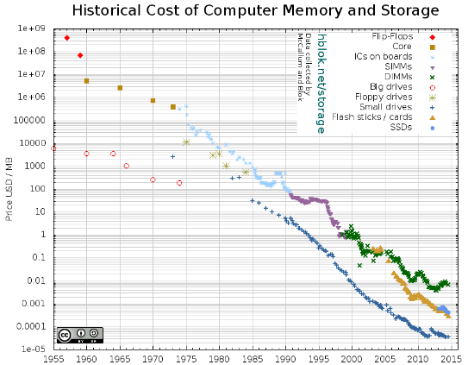
Tech Trend: Cost of memory
Lower cost means can
put more memory in
each server

Slide 13
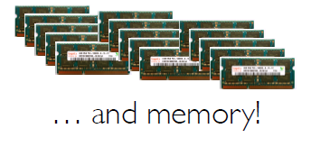
Current hardware for Big Data
Now that RAM cost is coming down,
Hard ware for bigdata:
Storage; many harddisks
Processing; CPU
Faster processing: RAM
Lots of hard drives
…. CPU’s

Slide 14

Opportunity
Keep more data in-memory
Chance for lighting fast cluster computing.
Design a new distributed execution engine:

Slide 15
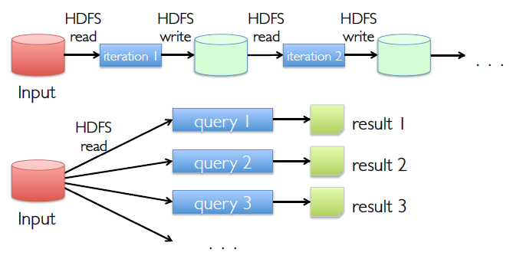
Use Memory instead of Disk
In map reduce, each iteration leads to HDFS I/O operations.
Adding to this, consider you have a source data, on which you want to perform different queries. Would you like to read the same data, for each query???

Slide 16
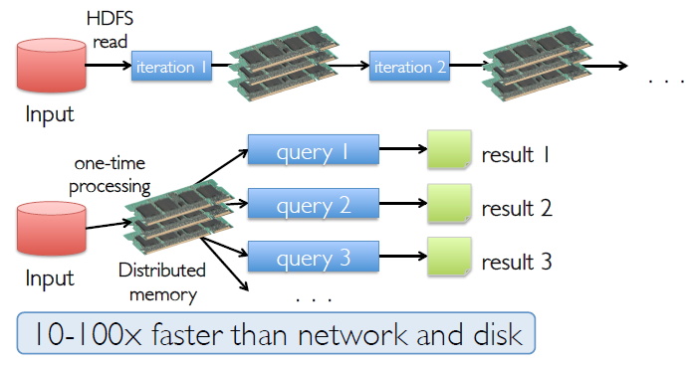
In-Memory Data Sharing
Now for faster processing and quick data sharing, use Memory.
In the previous example, you read the same data multiple times, now with distributed in memory, you have an option to cache data on distributed memory, perform all the required queries at much faster pace!!

Slide 17
Apache Spark Motivation
Using Map Reduce for complex jobs, interactive queries and online processing involves lots of disk I/O!
Keep more data in memory, when ever possible.

Slide 18
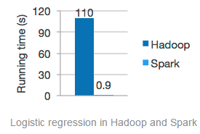
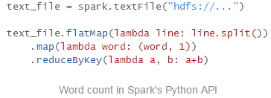

Key points of Apache Spark
Fast and general engine for large-scale data processing.
Speed; Run programs up to 100X faster than hadoop.
Ease of use: Write applications in language you are comfortable in; Java, Scala, Python and R.
Generality: Combine SparkSQL, streaming and complex analytics
Runs Everywhere: Spark runs on standalone, on YARN, on MESOS. It can connect to NoSQL, Amazon S3!!

Slide 19
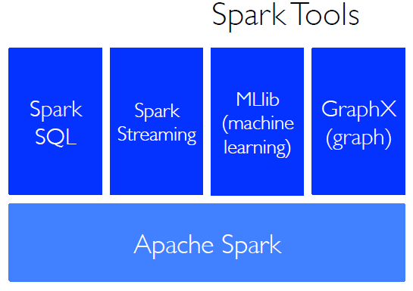
Rise of in memory computing; Ecosystem
Apache spark:
Core library for developers.
Spark SQL:
Enabling data analysts to write queries on spark.
Spark Streaming:
Real time analytics.
Mllib:
Machine learning libraries for predictive analytics
GraphX:
Graph Processing

Slide 20
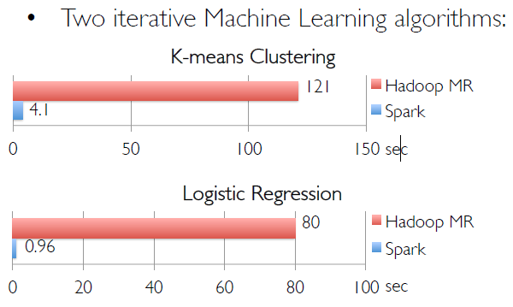
In-Memory can make a big difference
Iterative machine learning algorithms, will require multiple stages of jobs to predict the outcome.
In this case, Spark compared to Hadoop MR, runs near 100 times faster!!

Slide 21
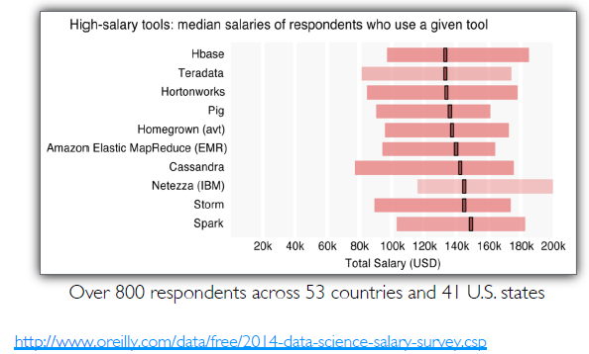
Spark is worth to learn!!

Slide 22
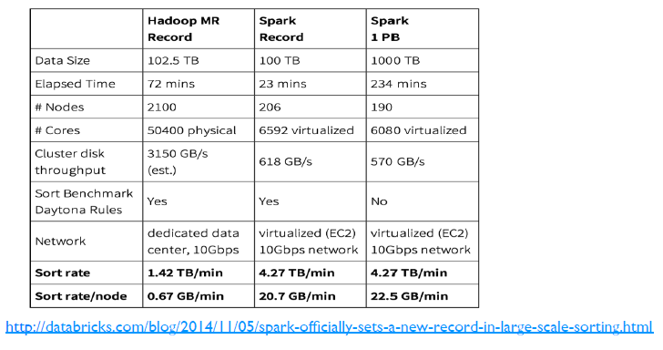
Stress Testing: First cloud peta byte sort!

Slide 23
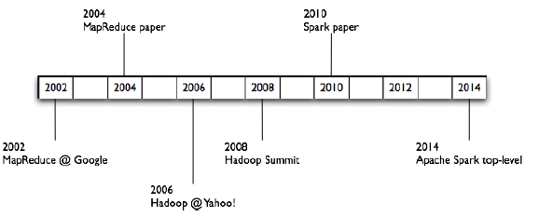
History Review

Slide 24
Conclusion
Spark is more like an advanced version of Map Reduce.
In Map Reduce, programmer is expected to know the entire frame work, and write them.
In Map Reduce, no matter how small the operation is, it will execute the full cycle, starting from mapper, shuffle and sort and reducer, if you even don’t want them to be executed.
Each Map Reduce job involves, lots of Disk IO.
Looking at the limitations of Map Reduce, spark designed almost 80+ functions, which will support your data analysis needs.
For example, distinct is a function in map-reduce, which will help you to find distinct values. If you were to do the same in Map Reduce, you should write another program!!
Spark tries to store data in distributed memory, whenever possible.
Spark is born out of map reduce, and used the lazy evaluation, data flow concepts of apache pig.

